Slide 1
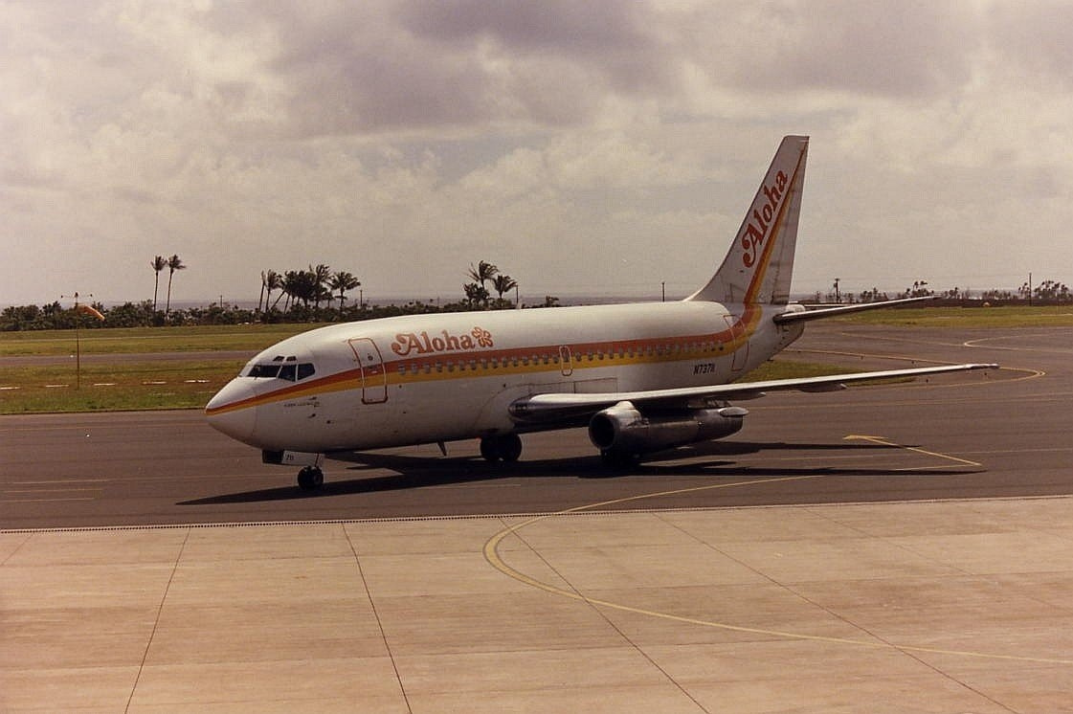
FALIURE OF ALOHA AIRLINES FLIGHT 243
Shahd Elsanet
Case Study

Slide 2
INTRODUCTION
How can a normal flight turn into a disaster in seconds?
Aloha Airlines Flight 243 started as a routine flight
Suddenly, a serious structural failure occurred
This caused injuries and loss of life
In this case study, we will analyze the failure, its causes, and how it was investigated

Slide 3
On April 28, 1988, Aloha Airlines Flight 243 was operating a routine passenger flight in Hawaii from Hilo to Honolulu.
At cruising altitude, a structural failure occurred when a large section of the upper fuselage (the cabin roof) suddenly ripped off.
This caused explosive decompression and severe damage to the aircraft’s structure.
One flight attendant was ejected from the aircraft and killed, and several passengers and crew were injured.
The pilots performed an emergency descent and diverted to Kahului Airport, where the aircraft landed safely

Slide 4
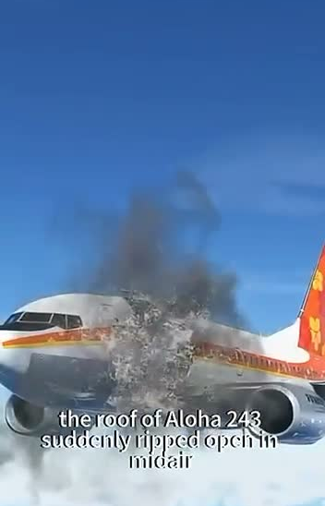

Slide 5
Faliure Analysis Methods
The investigators used several methods to analyze the failure :
they performed a visual inspection to identify the damaged areas.
fractographic analysis was used to study crack patterns.
SEM helped to examine the fracture surface in detail,.
while EDS was used to detect corrosion and material composition.
They also reviewed maintenance records to understand possible human or procedural errors.

Slide 6
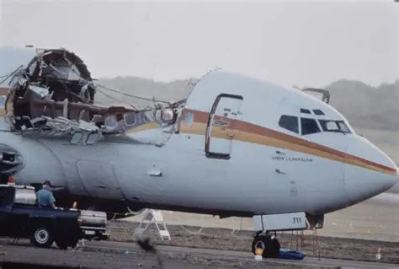
Causes of The Faliure
Metal fatigue from repeated pressurization
Corrosion in the fuselage structure
Cracks around rivet holes
Weak fuselage lap joints
Maintenance did not detect the damage early
Cracks grew slowly until the structure failed .
Old design led to cracks and structural weakness over time.

Slide 7
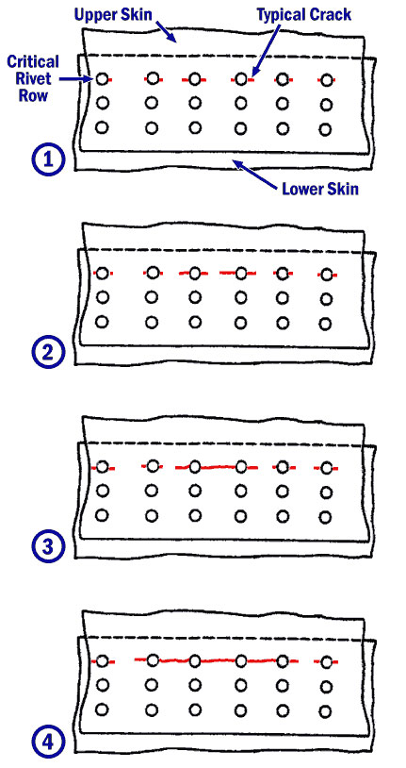
Root Cause
Fatigue cracks around rivet holes: repeated stress caused cracks to grow until failure .
Material and design issue: thin fuselage skin and cold-bonded joints made the structure more vulnerable .
rivet holes graph

Slide 8
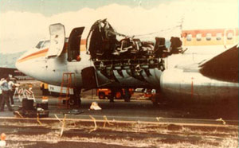
Solutions
Regular and detailed aircraft inspections
Use of advanced non-destructive testing (NDT) methods
Early detection systems for cracks and corrosion
Stronger and improved fuselage design
Better maintenance training for engineers
Strict safety regulations and supervision

Slide 9
Preventation Methods
Protective coatings: apply anti-corrosion layers on the fuselage to prevent moisture damage
Regular repainting: maintain coating quality and prevent surface degradation.
Surface inspections: check for cracks, peeling paint, or corrosion around rivets.
Improved materials/design: use better bonding methods and add extra protective layers

